Slide 1
Introduction to DSD Project --Computer Aided Scoliosis Diagnosis System
Rui ZHANG
CCST, Jilin University
Email: ruiATjluDOTeduDOTcn

Slide 2

Contents
Myself
CCST, Jilin University
My research and teaching
DSD JLU-UTAD
History
This cycle
Project
Background
Requirements
Possible modules

Slide 3
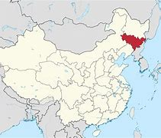

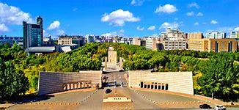



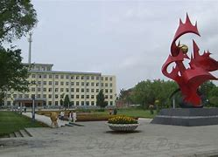
Rui ZHANG
Associate Professor, Jilin University
PhD of Univ. of Trento, Italy
Teaching in
‘Compiler Theory’
‘Distributed Software Development’
‘Knowledge and Data Integration’
Research on
Knowledge Representation and Evolution
Data integration and analysis

Slide 4
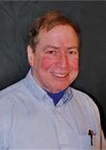
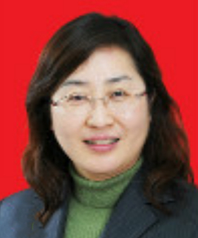
DSD
Founded by David Weiss and Ying JIN between ISU and JLU in 2000’s.
Partner schools: UO, UMKTT, PKU, UB, NUC, UTAD, UTN…
Project pool: PDA, FaceRec, Intelight, IndoorLoc, x-diagno…
Goal: a platform for cross-continent software development
Methodology: team-based project accomplishment
Tools: IM(wechat, etc.), github, email, M$-doc
Spirit: teamwork and cross-culture collaboration
Anything else…

Slide 5
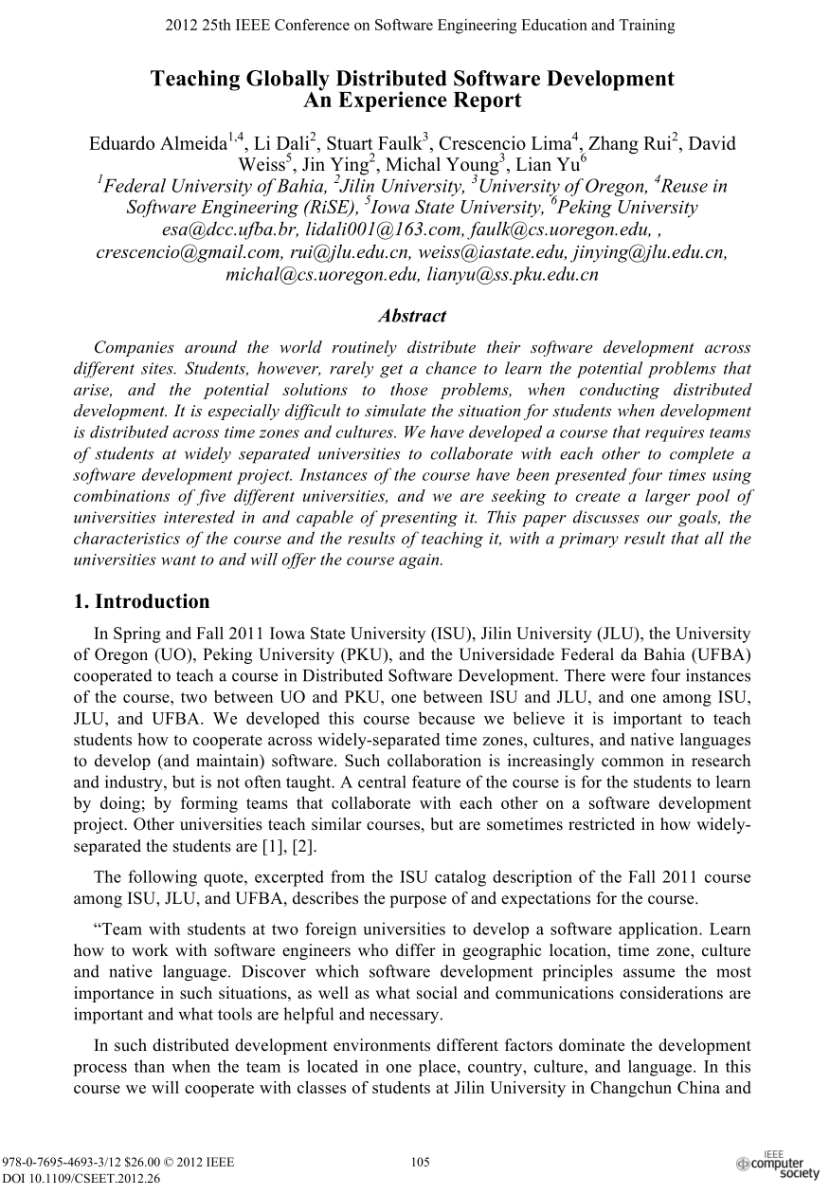
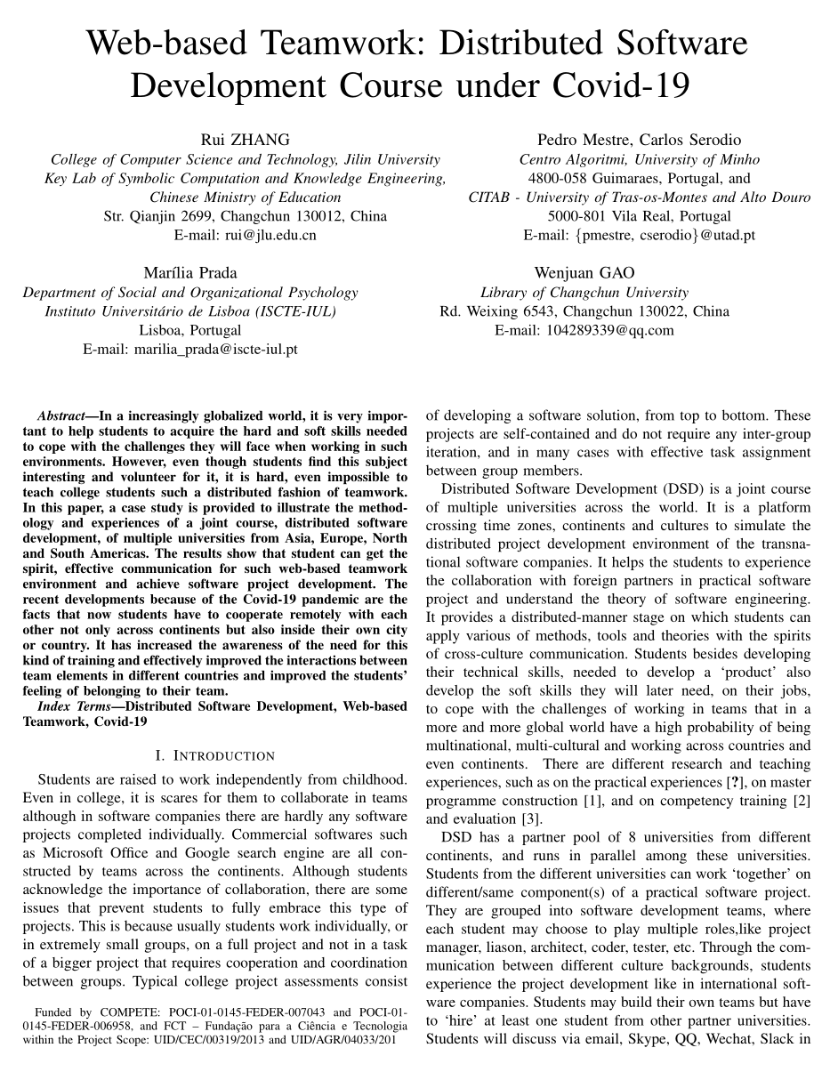
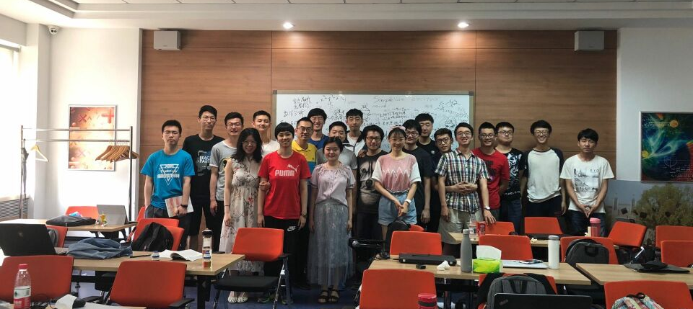
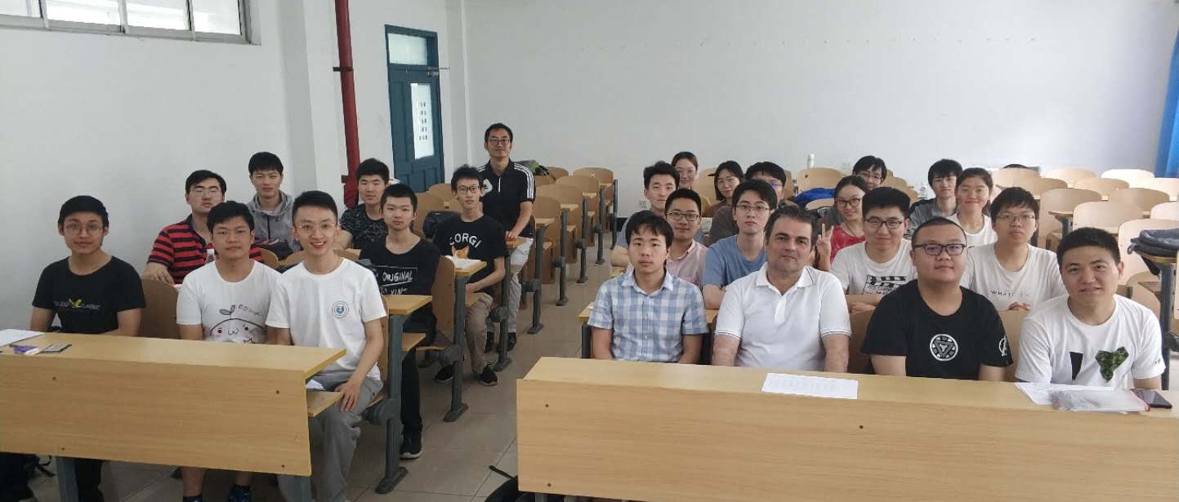
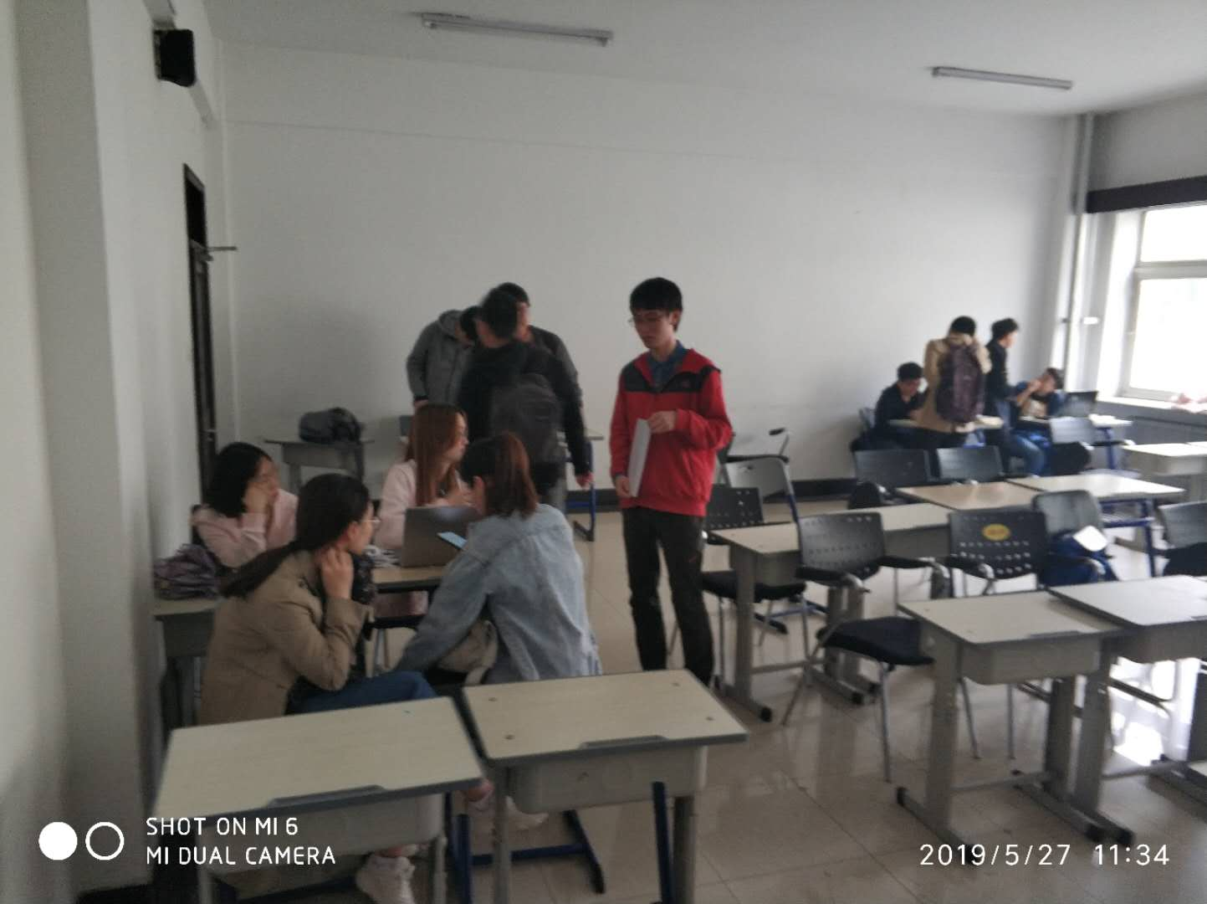
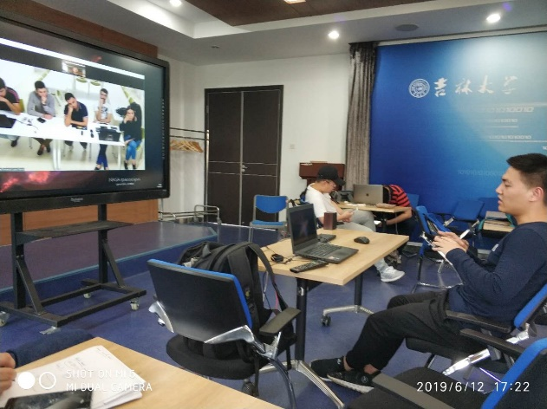
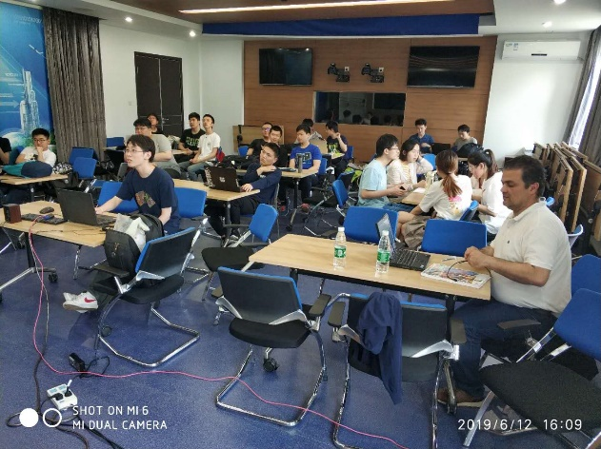
About Previous DSD in JLU

Slide 6
This cycle of DSD
27 Chinese undergraduates
TANG Aoqing
20 Portuguese postgraduates
4+4+12
12 weeks
JLU: 1330-1510 GMT+8 on Mon. & Thur.
UTAD: 1400-? GMT on Fri.
Team
<7 students per team
At least 2 from other university
Project
X-ray based scoliosis diagnosis system

Slide 7
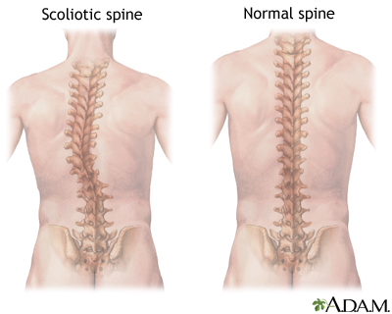
Project Background
Scoliosis is a sideways curve in your backbone (or spine).
The angle of the curve that measures more than 10 degrees on an X-ray is considered scoliosis.
In nonstructural scoliosis, the spine works normally but looks curved. In structural scoliosis, the curve of the spine is rigid and can’t be reversed.
Teenagers
often
https://www.webmd.com/back-pain/causes-scoliosis

Slide 8
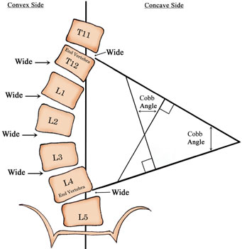
Classical Cobb Angle Calculation
Ends decision
Edge line extension
Vertical line drawing
Angle measurement
Types of cobb:
<=10°, negative
>10°, positive
>25°, brace treatment
>40°, surgical treatment
Error (instrumental)
3~5°
Reference to ongoing records

Slide 9
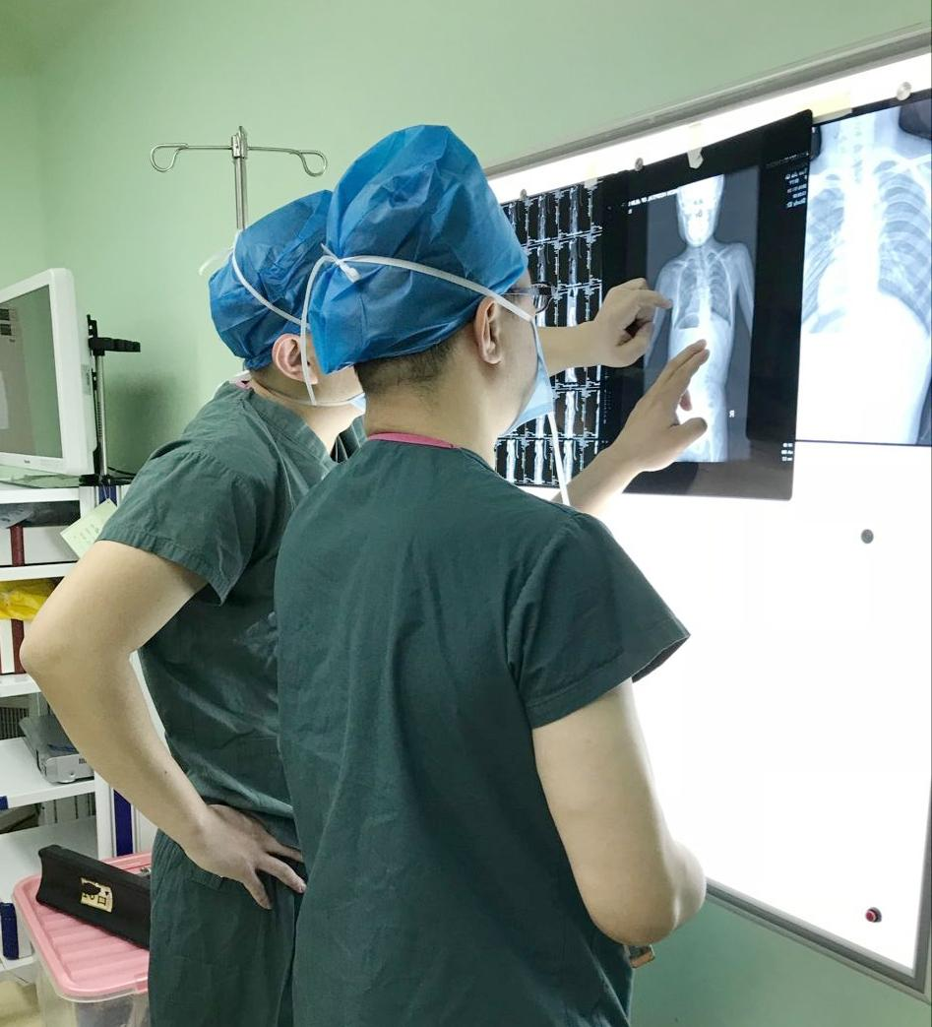
User stories about the system
Users
Doctor
Computer aided diagnosis
P-D relationship construction
Answer to patient
Patient
Early detection
Treatment progress monitor
Query to doctor
Admin
User management
Algorithm management
Treatment management
Recovery tracking

Slide 10
Possible modules
Server
Database
Algorithm
Communication
Client
Android
iOS
WeChat applet

Slide 11
Thanks for your attention!

